Slide 1

: Field of view (FOV)
: mmWave/Thz Beam
: LoS signal blockage
small BS
Obstacle
Obstacle

Slide 2
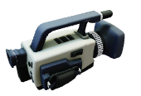

Slide 4

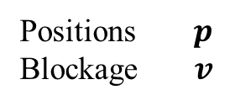

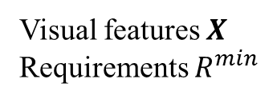
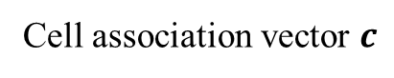
1) Input data acquisition
(Image acquisition & feature extraction)
3) UE detection
(object detection stage)
2) Input data transmission
Transformer-based Multiview
Object Detector
Visual features $X$
Requirements $R^{min}$
Positions $p$
Blockage $v$
5) Control command transmission
Cell association vector generation
CU in macro BS
Cell association vector $c$
UDN environment
4) Cell association decision
(CA stage)

Slide 5
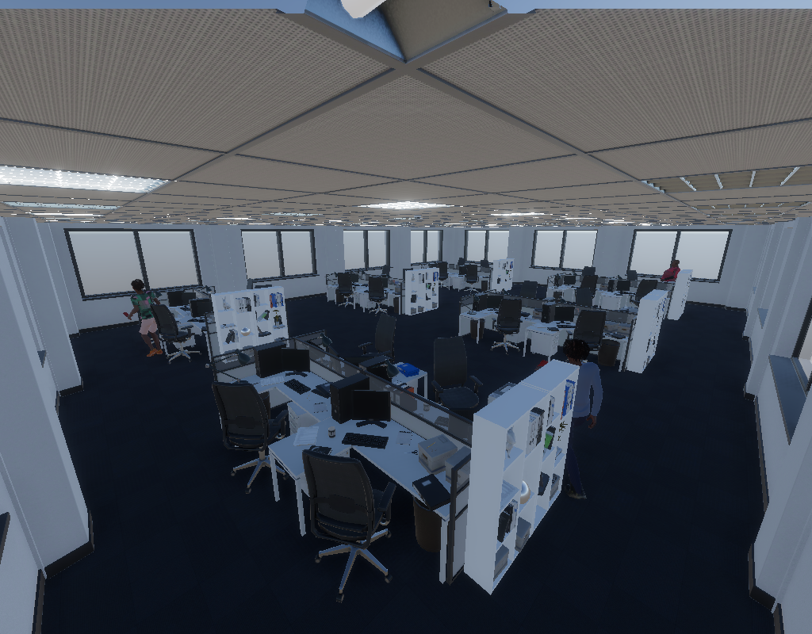
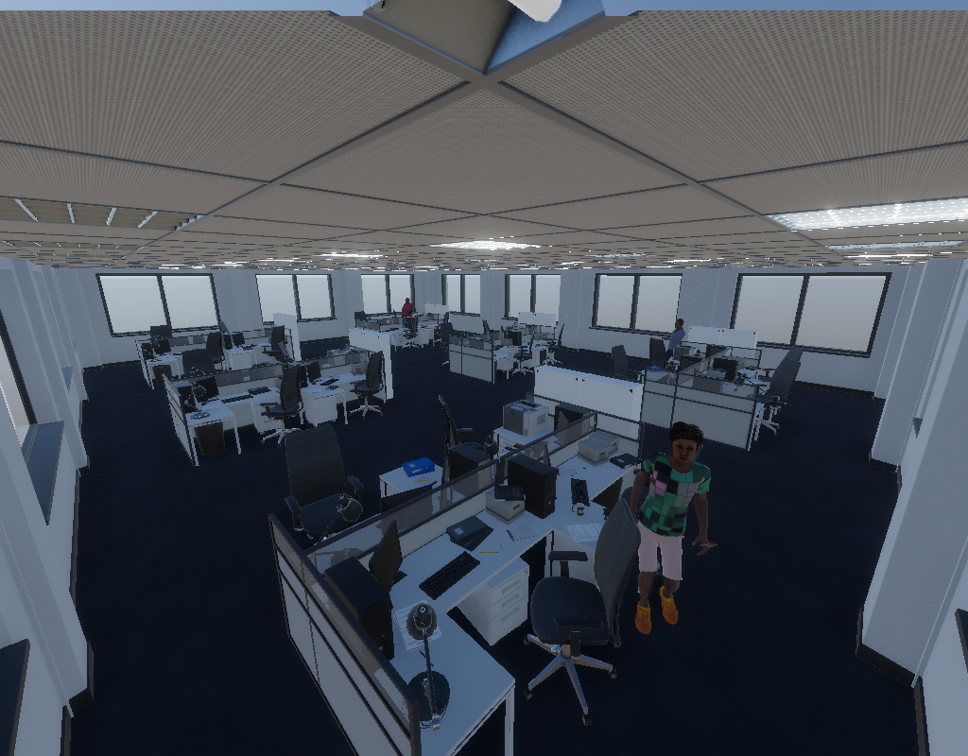
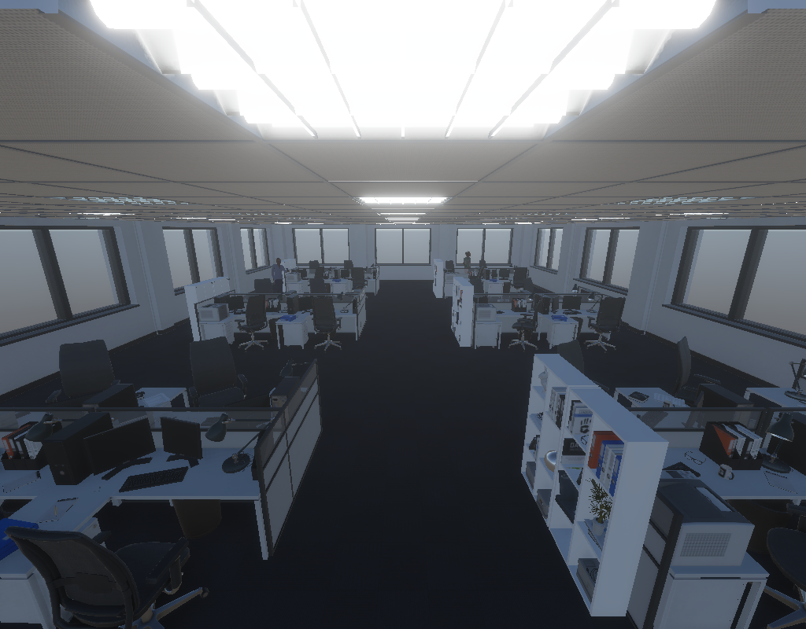
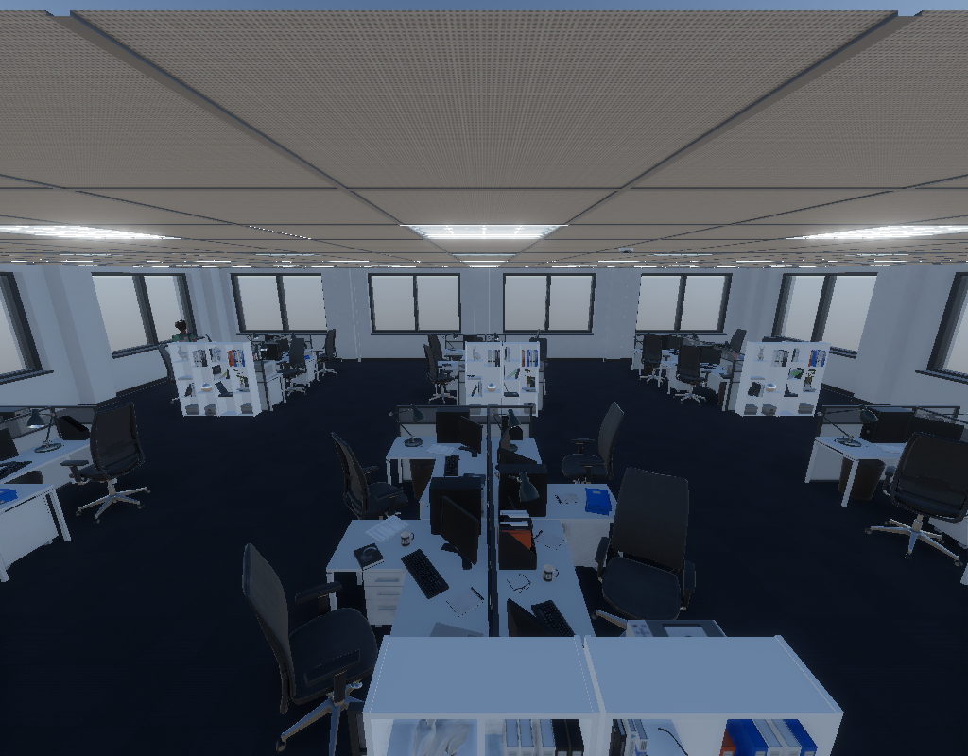
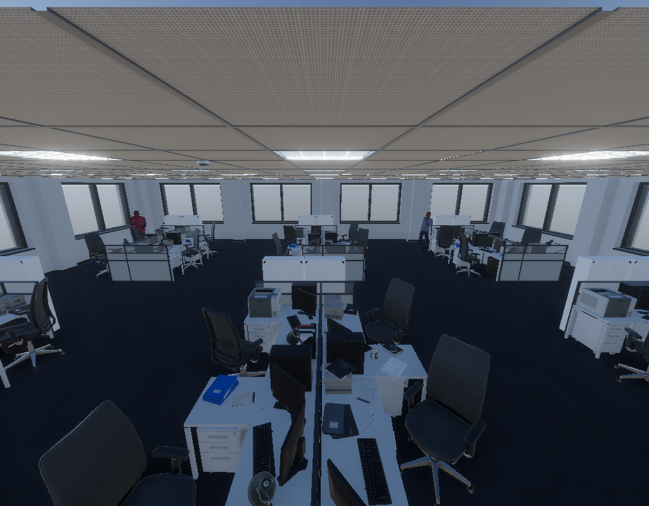
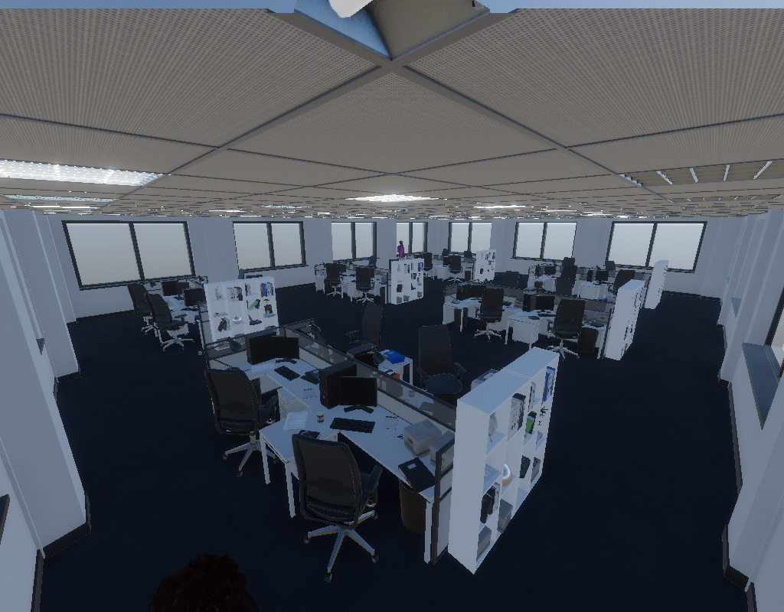
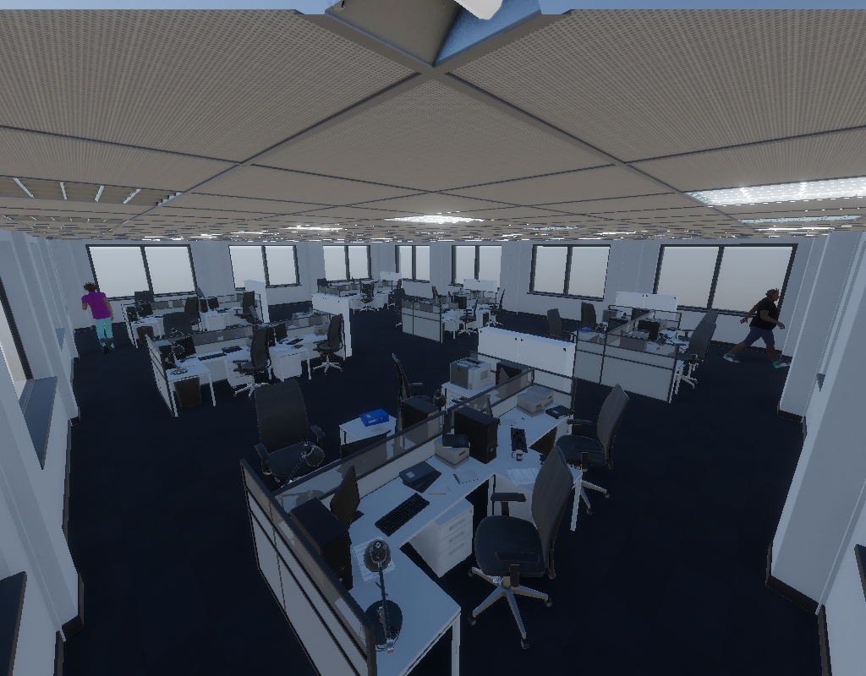
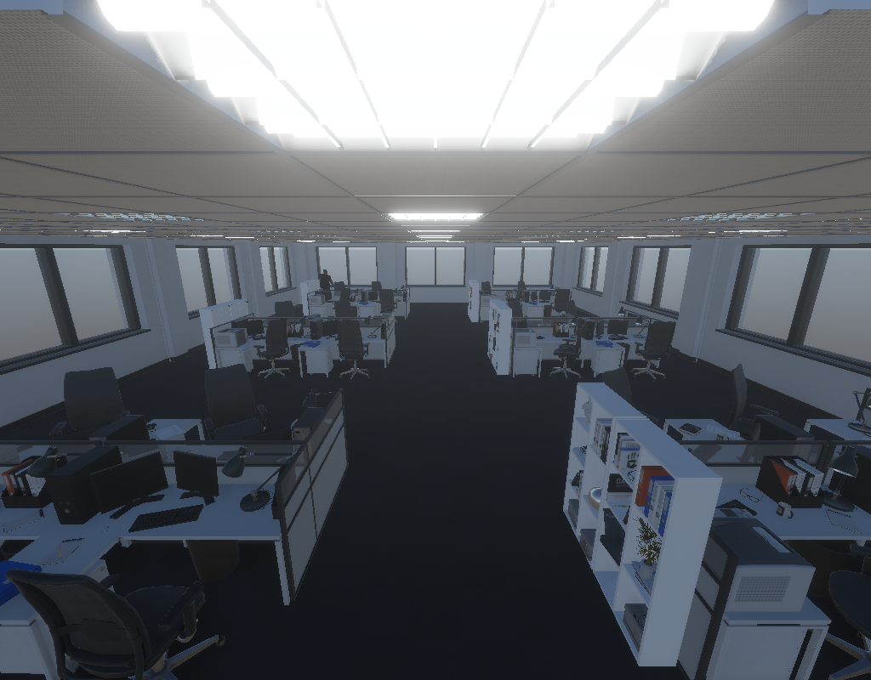
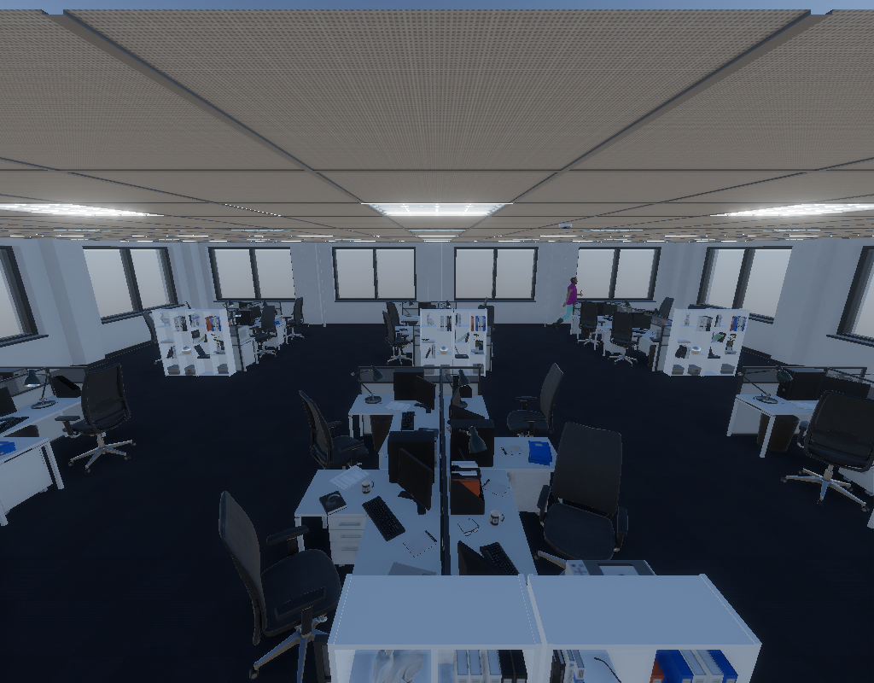
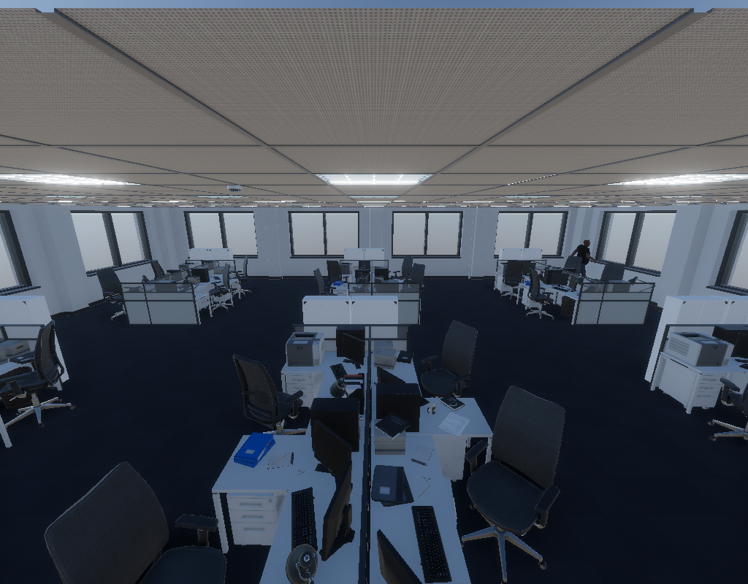

Slide 6
Multiview-based
Position and blockage
Transformer
Cell
association

Slide 7
Small BS

Slide 9
UE position &
Blockage indication
Feature
Feature
Feature
Decoder
Feature
Feature
Feature
Decoder
Feature
Feature
Feature
Decoder
Feature
Feature
Feature
Decoder
SWIN
FPN
Image
Image
Image
…
Position queries

